Slide 1
CS 3013 – Operating Systems
C Term, 2023
Instructor
Taylor H. Andrews, M.S. M.S.
tha@wpi.edu

Slide 2
Winter (+Covid) Considerations
Difficult to anticipate future developments
Goal: In-person instruction
Quizzes, lecture, activities
Tough Weather in C Term!
Pretty by day, cold by night…
Support for snowstorms, isolation, illness
Follow WPI safety policy communication
Don’t come to class sick!
Lecture capture recordings (after the lecture)
Auto-drops 2 lowest quizzes
Consult if more flexibility needed
Masks welcome, not required

Slide 3



Professor Background
Taylor H. Andrews, M.S. M.S.
Background:
WPI Computer Science, Class of 2012
Bachelor of Science: 2008 – 20012
Music Minor
MIT Electrical Engineering and Computer Science
Master of Science SDM: 2021
Research Assistant and Thesis in Energy Cybersecurity Group
Master of Science EECS: 2021
Teaching Assistant in EECS / Music Department
VMware Systems Software Engineer
ESX, Workstation, Fusion Hypervisor Products
Senior Member of Technical Staff (2012-2017, 2021-2022)
Courses this year:
Introduction to Programming for Non-Majors (CS1004)
Introduction to Machine Organization and Assembly Language (CS2011, +D Term)
Operating Systems (CS3013)

Slide 4
Personal Life
Playing Guitar, Drums with Friends & Family
About 10 years with books and online resources
Clarinet Lessons in Elementary School
Building PCs & Performance Benchmarks
Overclocking Means Cooling!
Audio Engineering, Recording Studio Builds
“Garage & Basement Noise Enablement”
Music Technology Rocks!
Quarantined, Distributed, Asynchronous Cloud Recording exploration
(free, just using Audacity and Google Drive)
Putting “Old Hardware” to Use
Sustainability is Critical to Future…

Slide 5
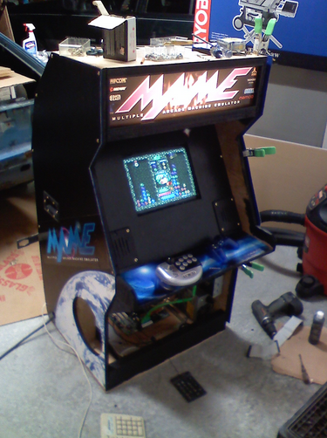
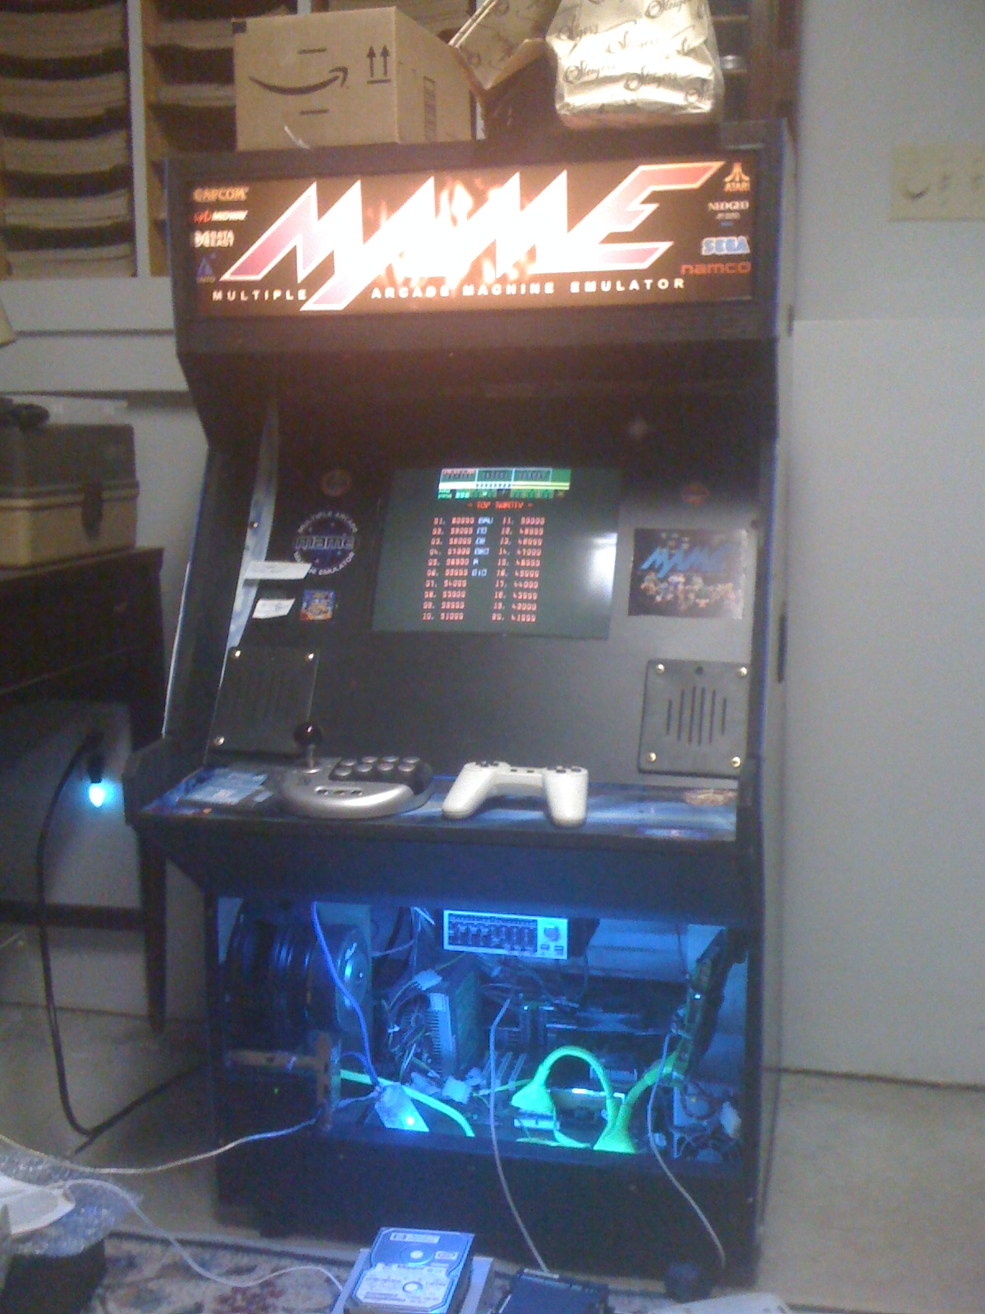
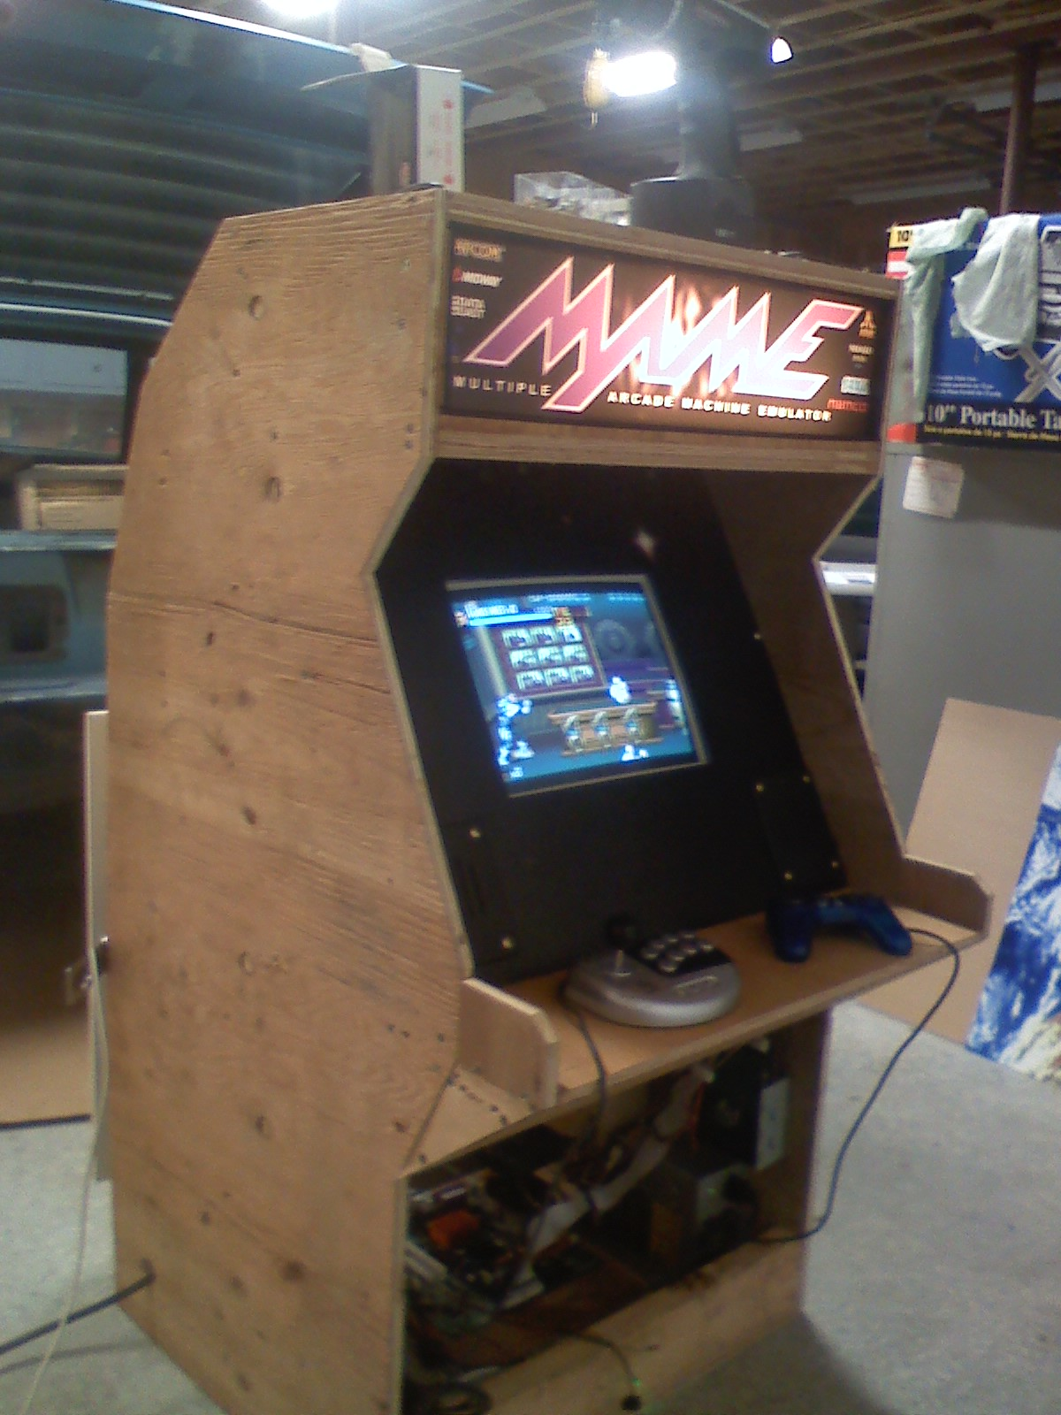
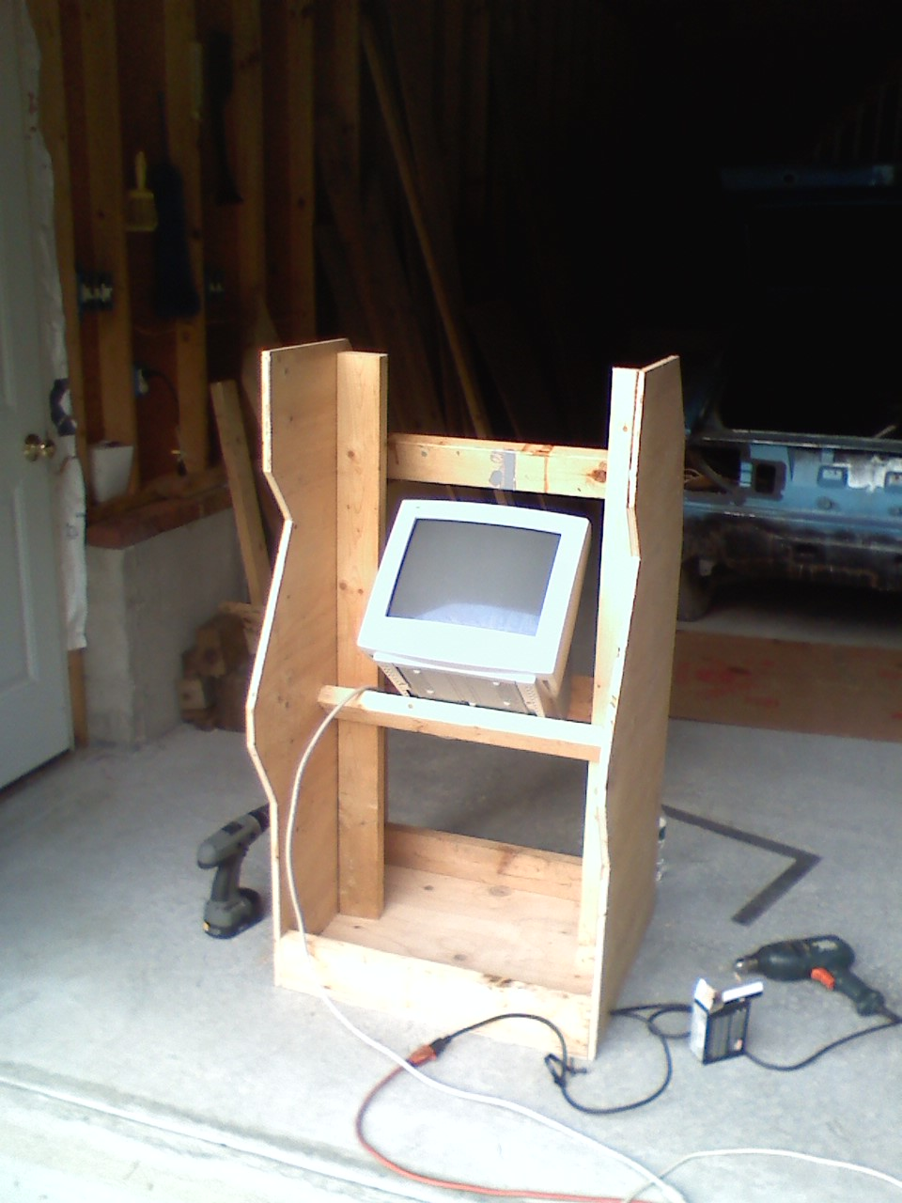
“Old Hardware” Projects
Scrap Arcade Machine & Case Art
Before Raspberry Pi Days…
IT Service Exchange (with Sign Company)
Think About Deal “Values” Before Money

Slide 6
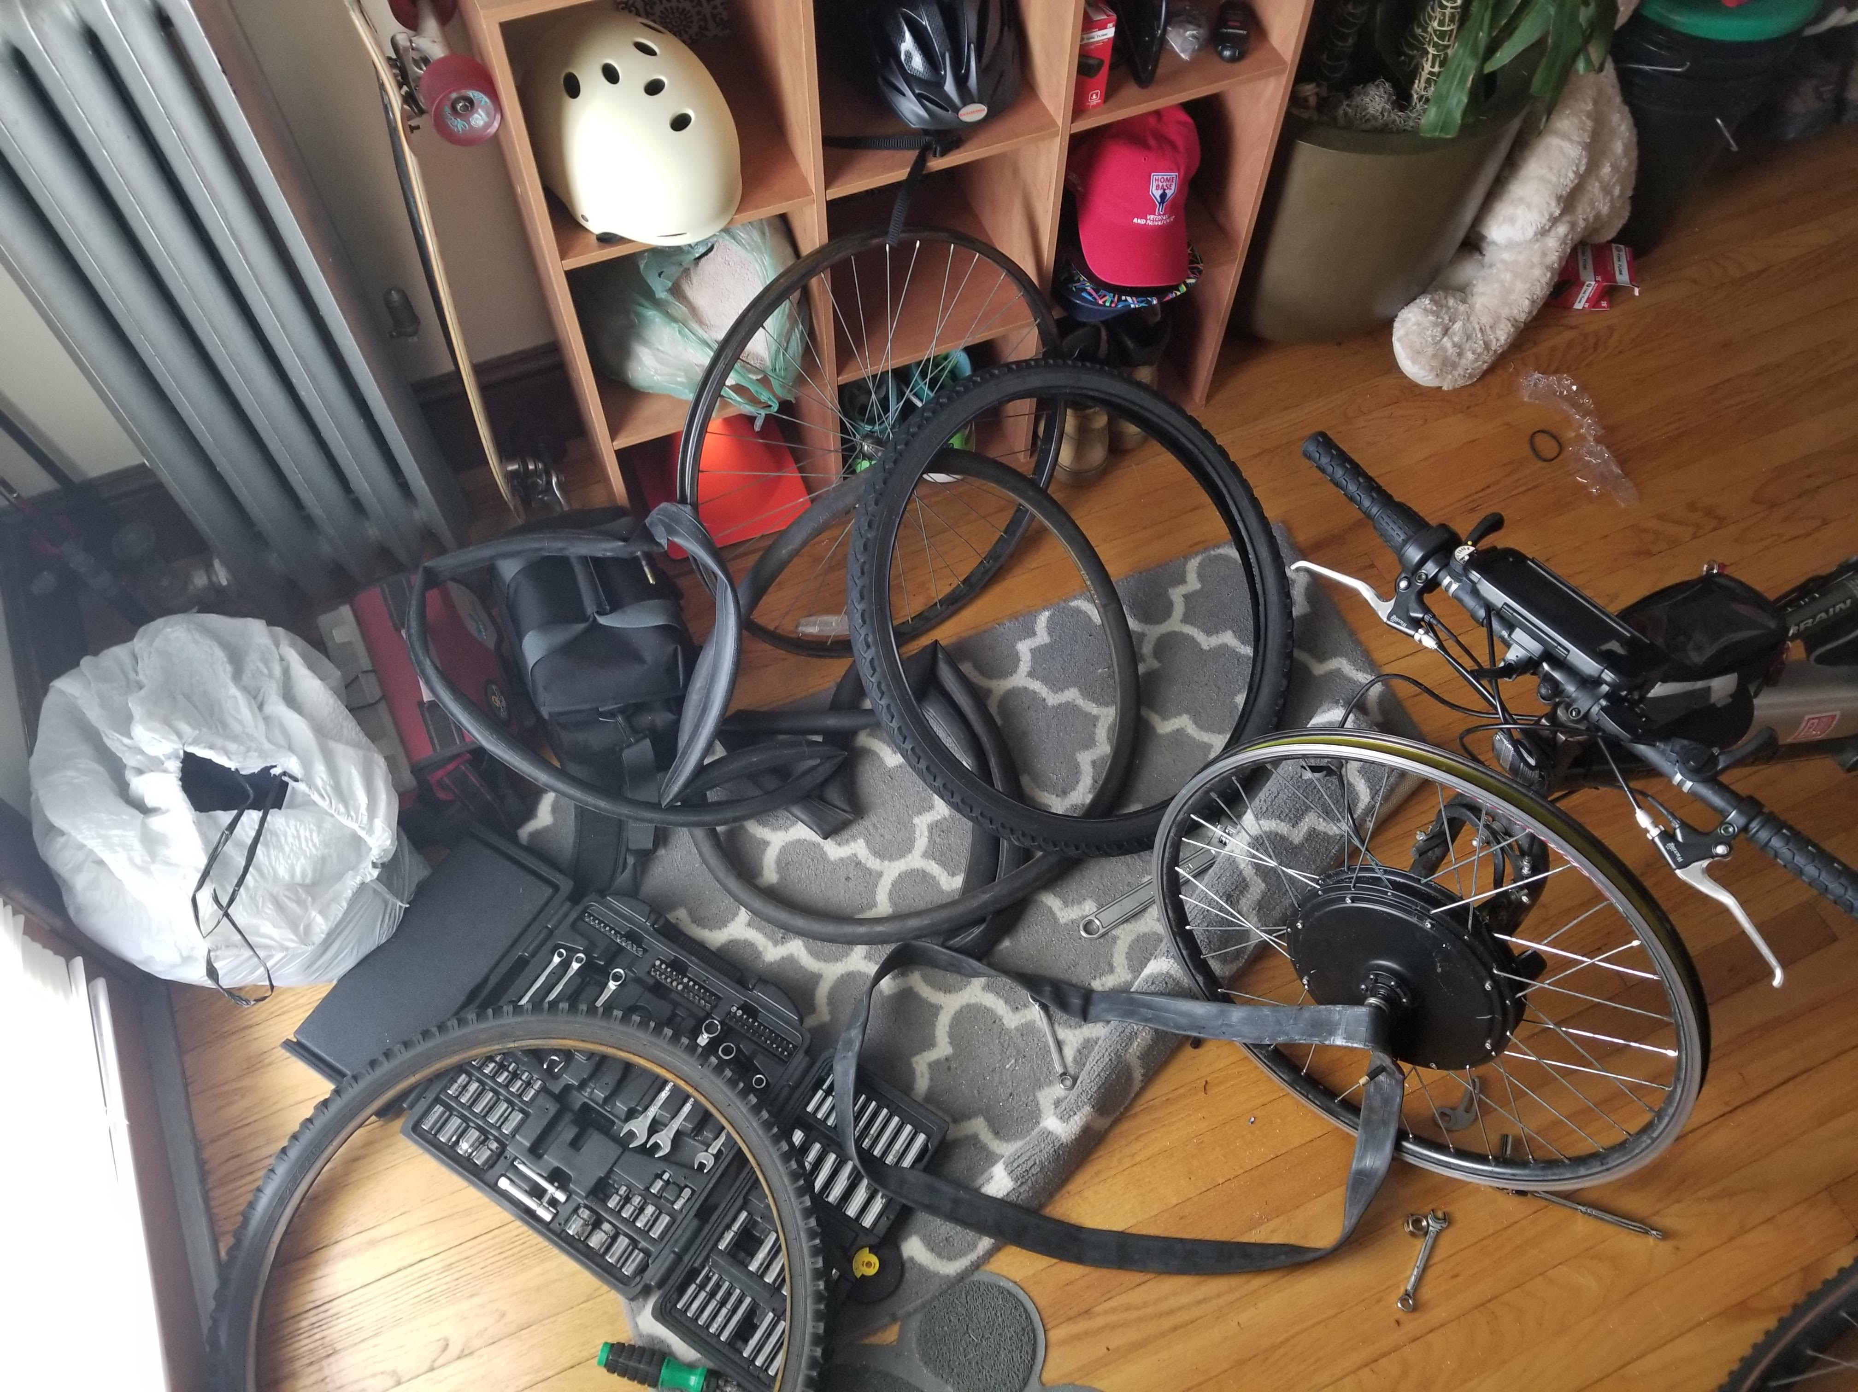
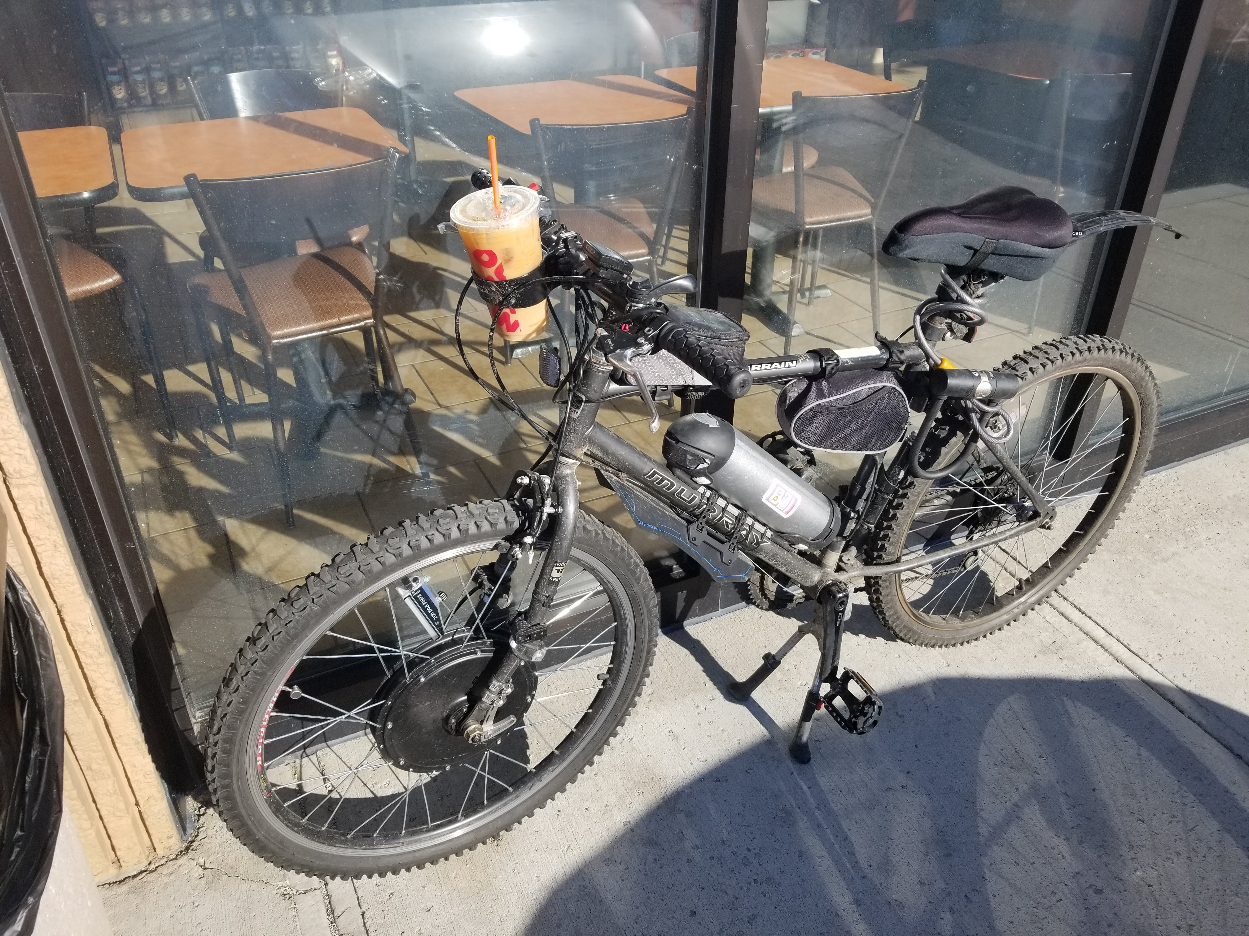
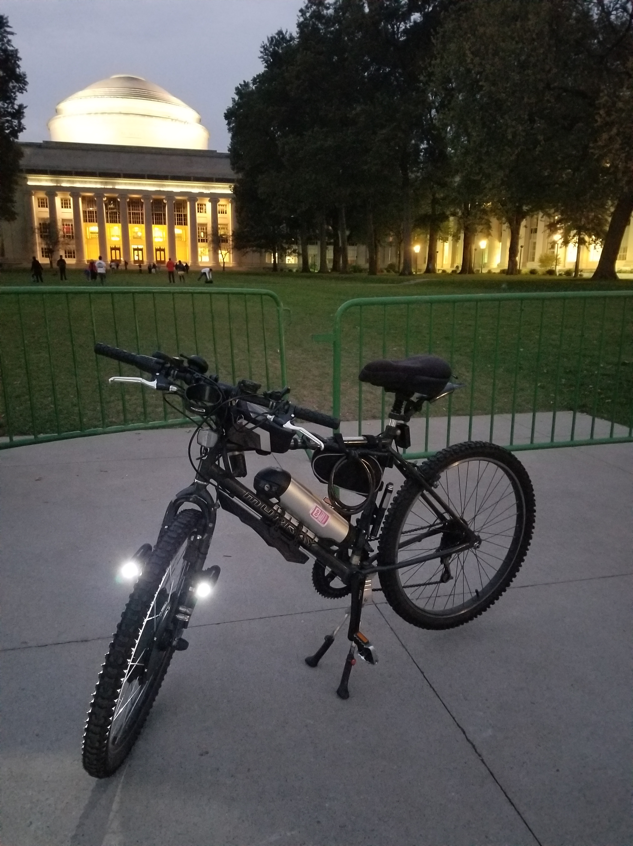
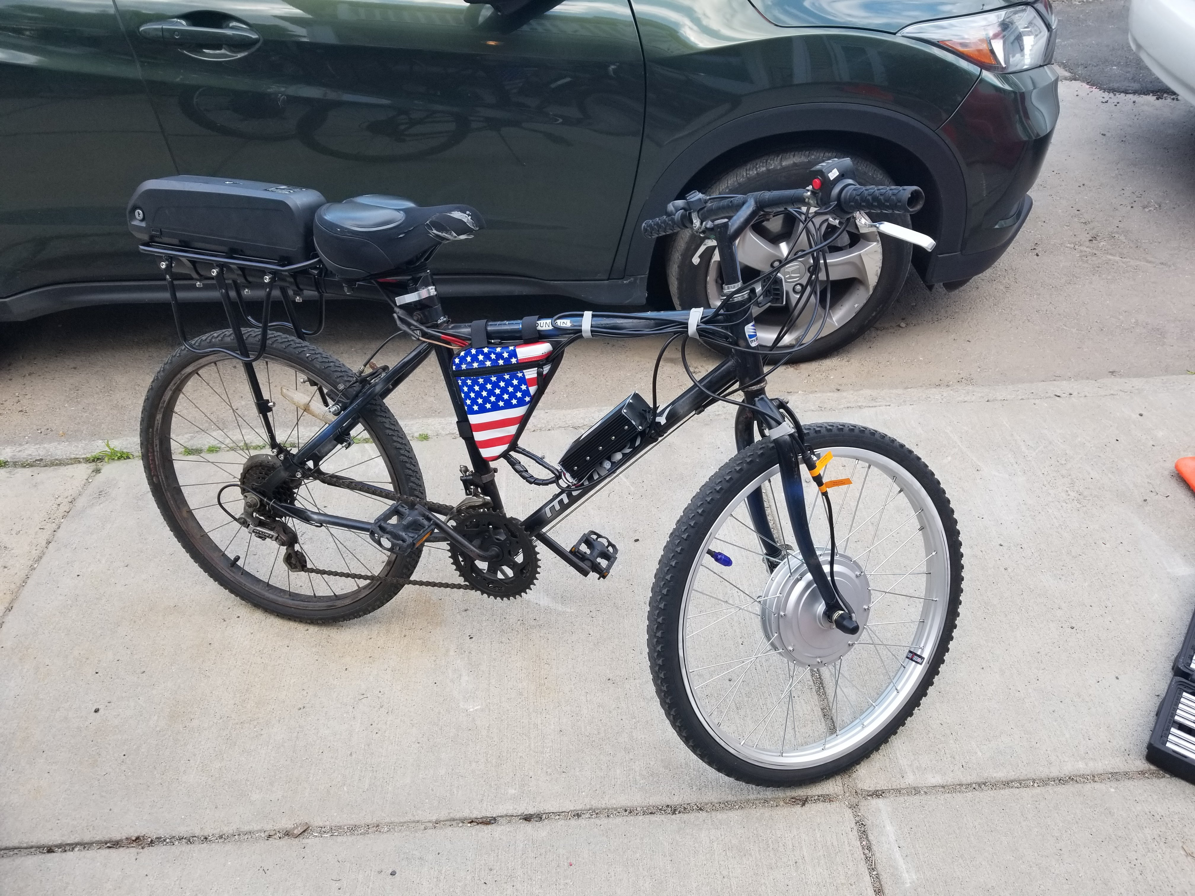
“Old Hardware” Projects
Recycled Mountain Bikes’ E-Bike Conversions
Steel Mountain Bikes + Torque Arms + eBay Kits + Batteries
Affordable and sustainable recycling of discarded cheap steel-frame bicycles
Poor Quality Torque Arms & Batteries can be dangerous!

Slide 7
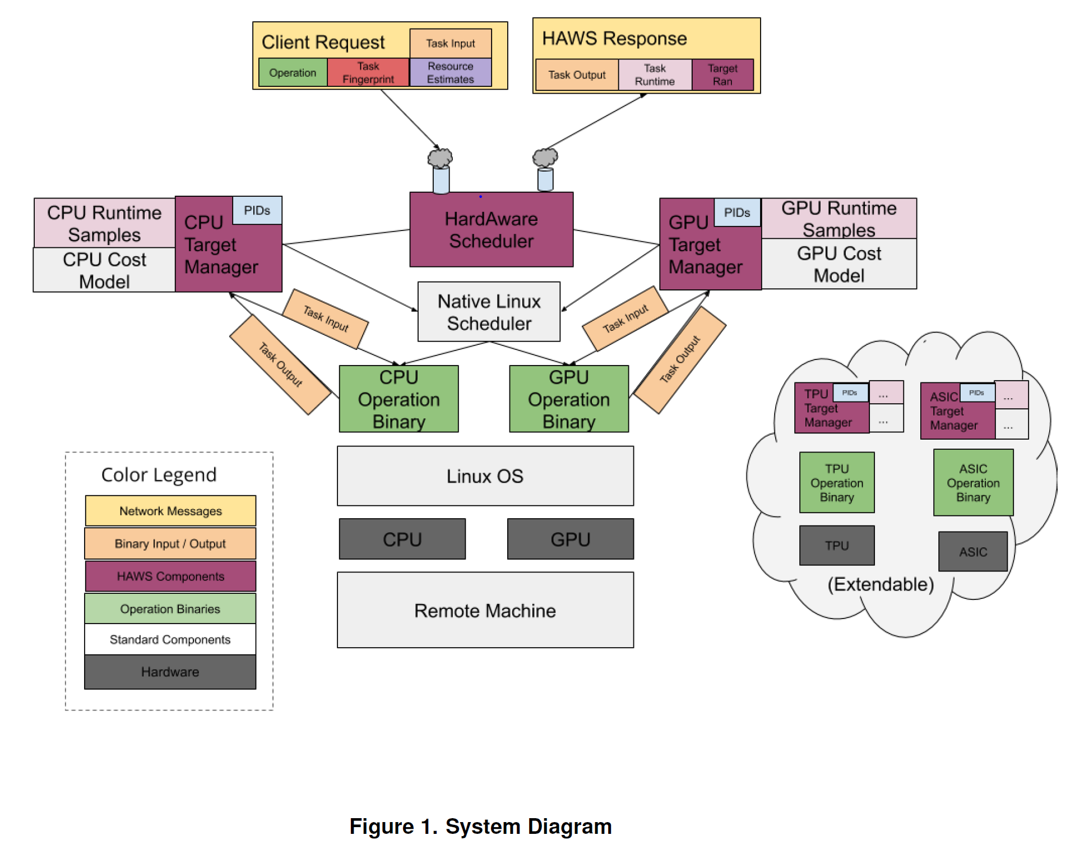
OS Research - HAWS
“HardAware Scheduler”
Figure 1. System Diagram

Slide 8
Your Research Interests
Interested in an MQP?
Software Systems, Hardware, or Security?
RBE / ECE / IMGD Co-Advising
Music & Audio Software Projects & Collaborations
Let’s talk!

Slide 9
Operating Systems – C24
Department Rolling Out New Infrastructure
Adding Browser-Based Cloud VM Access
Details during “Project 0 – Setup”
Department VM Feedback Is Valued
Visit WPI CS Student Virtual Machine Page
Send Feedback to Mike Voorhis (mvoorhis@wpi.edu)
My First Time Teaching CS3013
Fedora Linux and VMware Workstation given to me as an early teen
20 Years OS Experience
Thankful for Linux and Windows NT Kernel… you will be too!
Please Speak Up, Reach Out, Come to Office Hours
80+ Enrolled
Large Lecture Setting vs. Small Group Setting
I hope to get to know you all, and keep learning with you too

Slide 10
Additional Teaching Staff
TA: Chao Wang, CS Ph.D. Candidate
SA: Timory Goggin, MA + CS B.S. B.S.
SA: Sapphire Hu, CS + ECE B.S. B.S.

Slide 11
Course Structure
Daily Quizzes
Projects
Online Tools
Forum, Teammate Requests, Quizzes
Grades and other materials are posted online

Slide 12
How to Succeed in this Course
You need to have a solid C background
Recommended: CS 2301 or CS 2303
Get help when you are stuck
Do not spin your wheels
The teaching staff is here to help
Leverage each other (but do your own work)
You need to start early
These projects can’t be done (well) in a day
15+ hours per week

Slide 13
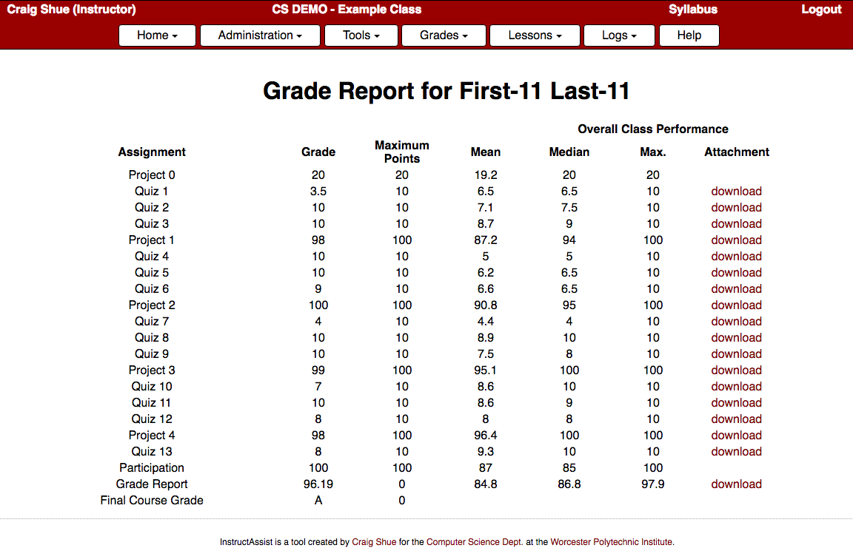
Grades
Automatically posted online via InstructAssist
https://ia.wpi.edu/cs3013-andrews/grades.php
Hard copies graded by TAs, scanned in, and attached to your assignment in the grade book
Aiming for a 48 hour turn-around (faster if possible)

Slide 14
Teams
You can work in teams or by yourself
Teams of up to 2 people
https://ia.wpi.edu/cs3013-andrews/request_teammate.php
Option 1: Use WPI username to select teammate
Teammate gets an email; must click link to confirm
Option 2: Ask to be randomly assigned a partner
Option 3: Do nothing (work alone)
Partner evaluations after each project
Demonstrations possible
Teams must be selected for each project

Slide 15
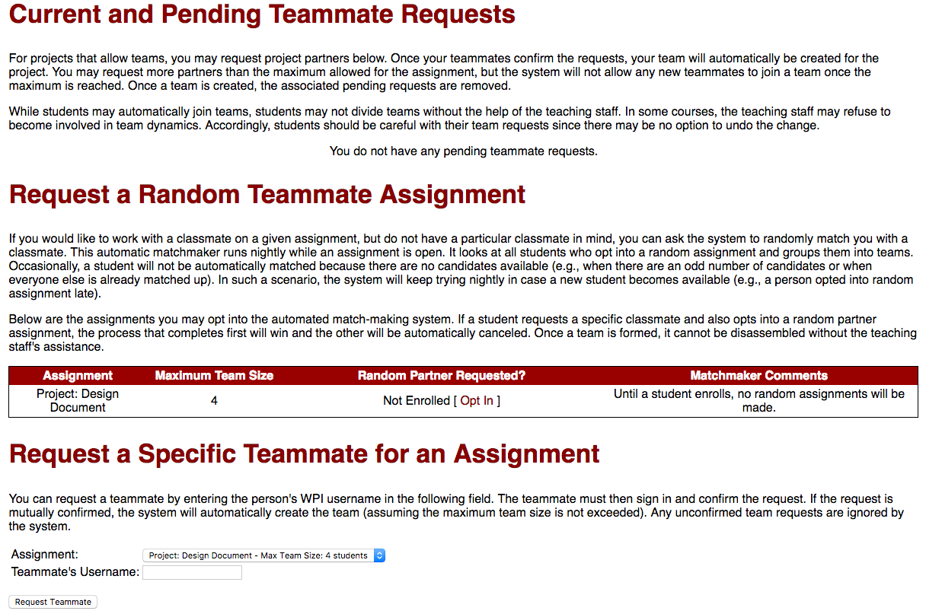
Requesting a Teammate

Slide 16
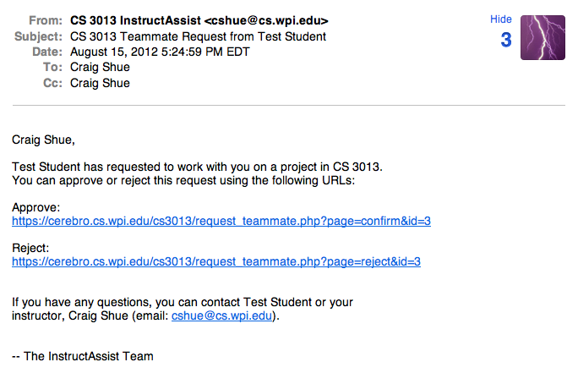
Requesting a Teammate – 2

Slide 17
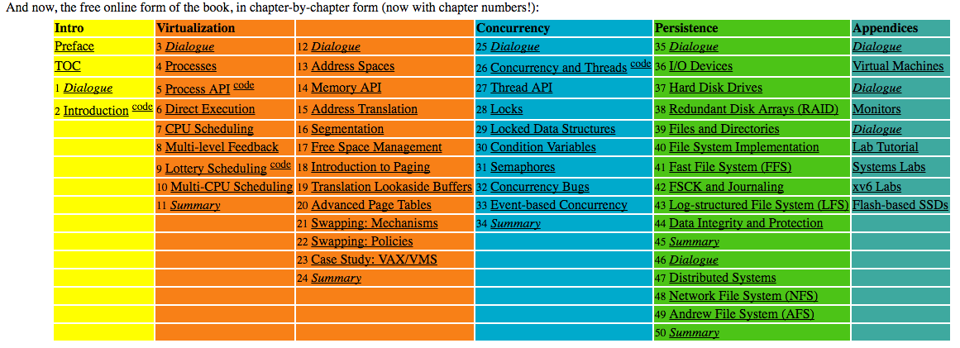
Syllabus
Online: http://web.cs.wpi.edu/~tha/cs3013/
Academic misconduct
Most cases are misunderstandings. But, it is still unpleasant for everyone.
Textbook: (free online or $10 e-Book download)
http://pages.cs.wisc.edu/~remzi/OSTEP/
17

Slide 18
Why are you here?
Little Question

Slide 19
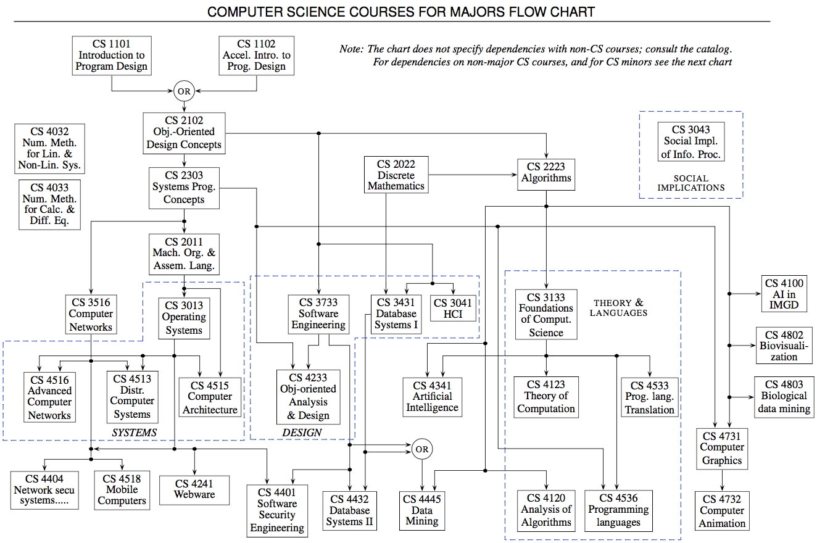
Extremely Practical Reasons
The blue fence of dooooooom!

Slide 20
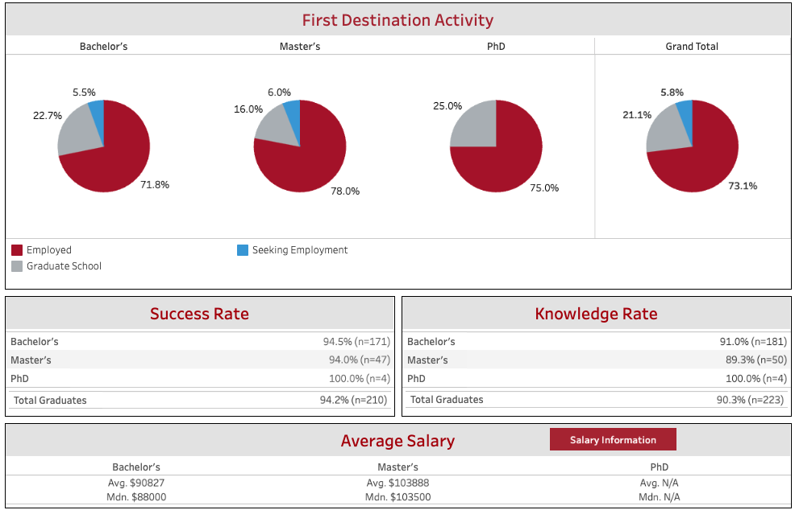
Yet More Practical Reasons
Data Source: https://public.tableau.com/app/profile/wpi.institutional.research/viz/FirstDestinationSurveyDashboard/NEW-PublicFDSOutcomesReport

Slide 21
More Meaningful Reasons
A Meaningful Life
Camping Philosophy
Having an Impact
Advancing Humanity

Slide 22
Operating Systems are Foundational
“I want to make computers dance for me.”
“Nobody has time for all the crazy details.”
Abstraction
“All these devices… it’s like herding cats!”
Resource Manager
With the right abstractions and resource management, you can get to making your impact faster.

Slide 23
Topic List
Virtualizing the CPU
Virtualizing Memory
Concurrency
Persistence
History

Slide 24
Processing Basics
Von Neumann Model
Fetching Instructions
Decoding Instructions
Executing Instructions

Slide 25
What is an OS?
It’s everything running (including a Web browser)…
It’s that black and white text screen…
It’s that thing that keeps crashing on me…
It’s irrelevant these days…
It’s just really hard to define?

Slide 26
Key Aspects of an OS
An abstraction
A resource manager

Slide 27
Key Aspects of an OS
An abstraction
Not worrying about sectors, cylinders, high/low voltages
Essentially a metaphor that’s easier to work with
What is a file? What is an account? What is a process?
A resource manager

Slide 28
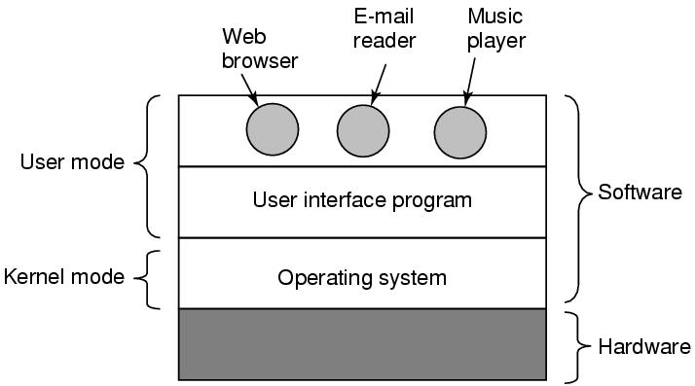
Interfaces

Slide 29
OS as a Resource Manager
Allow multiple programs to run at the same time
Manage and protect memory, I/O devices, and other resources
Includes multiplexing (sharing) resources in two different ways:
In time
In space

Slide 30
Virtualization
Virtual Machines and Virtualization
Both are crafty lies
But why do we lie?

Slide 31
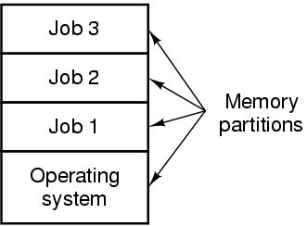
Powered by Lies: Multiprogramming (Concurrency)

Slide 32
Activity – Multiprogramming
Actors:
Processor
Cache
Main Memory
Magnetic Disk
Job 1 Task
Job 2 Task

Slide 33
Activity – Multiprogramming
Job 1: compute, request disk I/O, compute, cache retrieval, compute, memory access, compute, disk I/O, terminate
Job 2: compute, cache retrieval, compute, disk I/O, compute, memory access, compute, terminate

Slide 34
Persistence
Keeping things around after a reboot
Why is this such a big deal?
Hard Drives
SSDs
File Systems

Slide 35
History of Operating Systems
Generations:
(1945–55) Vacuum Tubes
(1955–65) Transistors and Batch Systems
(1965–1980) ICs and Multiprogramming
(1980–Present) Personal Computers
Modern servers are like industrial scale PCs
Is the “Cloud” an OS?

Slide 36
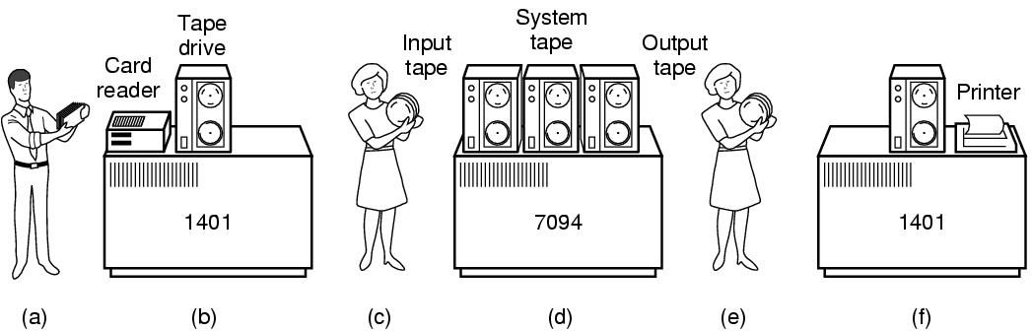
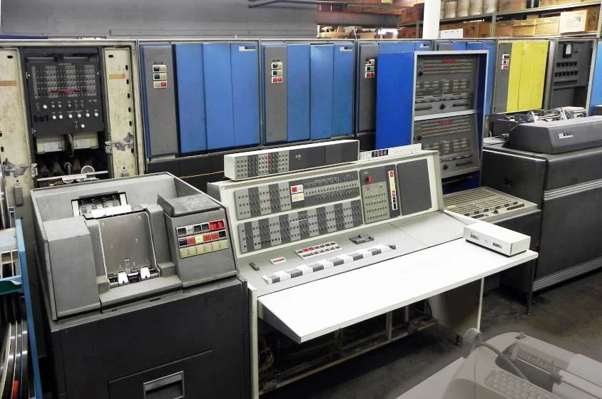
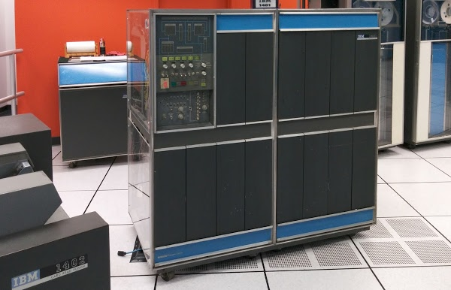
Batch Systems
https://www.righto.com/2015/10/repairing-50-year-old-mainframe-inside.html
ibm 7094 mainframe and tapes - Search Images (bing.com) / Columbia University

Slide 37
Multiprogramming

Slide 38
The Read System Call
Implement the following user program in user code, a read library, and the kernel
int num_bytes;
char *buffer;
int file_descriptor;
read(file_descriptor, buffer,
num_bytes);

Slide 39
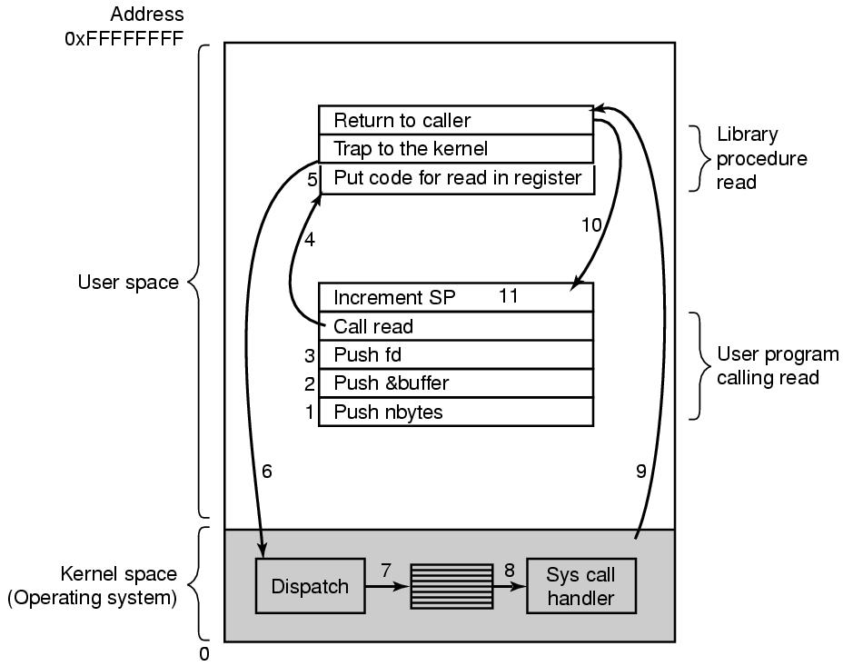
System Calls

Slide 40
Instructions
User Program
Hand to stack num_bytes, buffer, file_descriptor
Call read library
Read Library
Store the syscall value for “read” in a register
Trap to the Kernel
Kernel Dispatcher
Catch trap to kernel (“dispatcher”)
Read register value to understand which syscall it is
Kernel Syscall Handler (“Read”)
Run that syscall code
Return to the caller (switch back to user mode)
Read library
Return to caller
User Program
Increment stack pointer

Slide 41
Administrative
Project 0 and 1 discussion
Specification
Team logistics
Discussion Questions

Slide 42
Discussion Questions
What makes something a “computer” and what necessitates an “operating system”?
Why do we have the system call process? Why is it the way it is?
How does the kernel call function in user space?

Slide 43

The End is Near

Slide 44
Test Quiz
(is it a “test” or a “quiz”? Make up your mind, Craig…)

